Slide 1
Comparing Proteolytic Fingerprints of Antigen-Presenting Cells during Allergen Processing
Hofer, H., et al. International Journal of Molecular Sciences. 18(6), 1225. 6/8/2017
Ann Le, Liam Fitzgerald 6/26/17

Slide 2
Why should we care about allergen processing?
In industrialized countries, allergies affect about 25% of the population.
Current treatment options are based on formulated allergen extracts -> potential shift to purified extracts or epitopes.
Protein-based allergy therapeutics involves determining B and T cell-reactive regions on antigens.
Techniques for studying allergen degradation/processing can be translated to viral protein degradation and epitope processing, and later vaccine development.
Notes:
Sought to analyze endolysosomal degradation patterns of inhalant allergens

Slide 3
MHC II Pathway with
Professional Antigen-Presenting Cells (APCs)
Professional APCs include Dendritic Cells (DCs), B cells, and Macrophages.
Protein antigen
Endolysosome
APC
APC
APC
APC
Peptides
T cell activation and development of adaptive immune response
APC
APC
MHC-II molecules
Notes:
Antigenic peptides are presented on MHC-I molecules to CD8+ cells and on MHC-II to CD4+ cells.
MHC-II complexes are expressed only on APCs.

Slide 4
Allergens were first purified from E. coli and P. pastoris
Bet v 1 (birch pollen)
Amb a 1 (ragweed)
P. pastoris
E. coli
Der p 2
(house dust mites)
proDer p 1
(house dust mites)

Slide 5
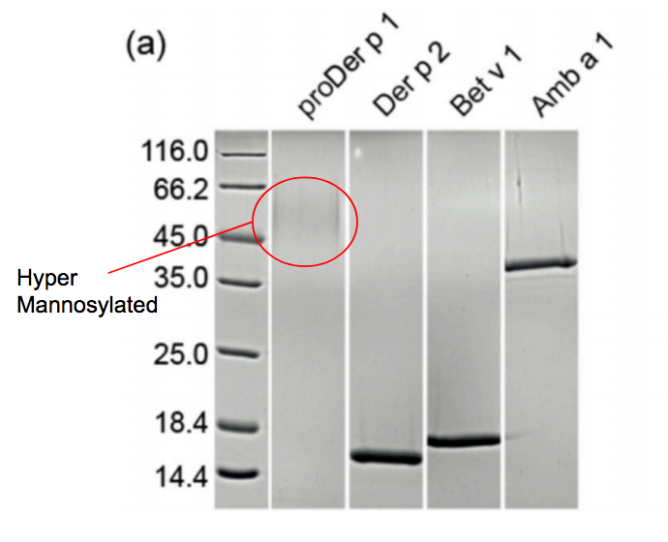
Purification of Recombinant Allergens
Notes:
15% SDS-PAGE gel.

Slide 6
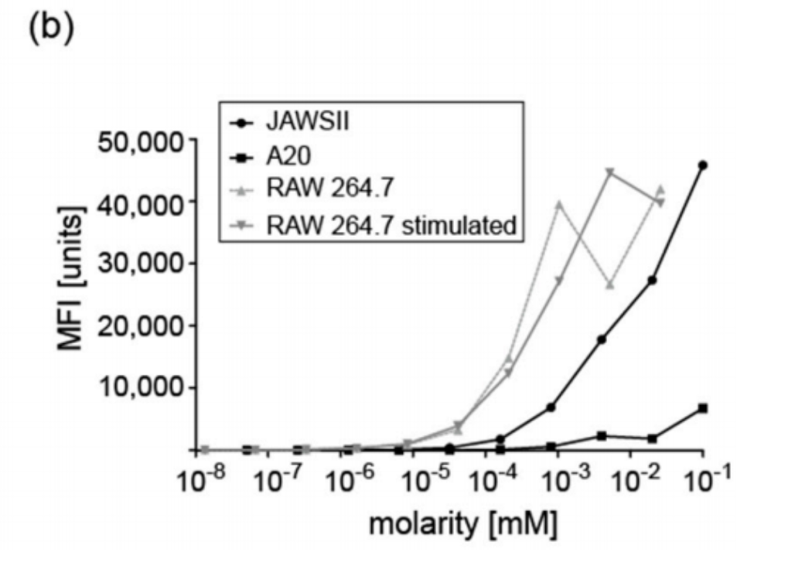
Endolysosomal proteins were isolated from three different APCs and protease activity determined using a fluorescent substrate.
JAWSII dendritic cells
A20 B cells
RAW 264.7 macrophages (activated and inactivated)
Notes:
Activated using LPS
RAW 264.7 macrophages displayed highest proteolytic activity using substrate, followed by JAWSII and A20 B cells
No different between JAWSII stimulated and unstimulated

Slide 7
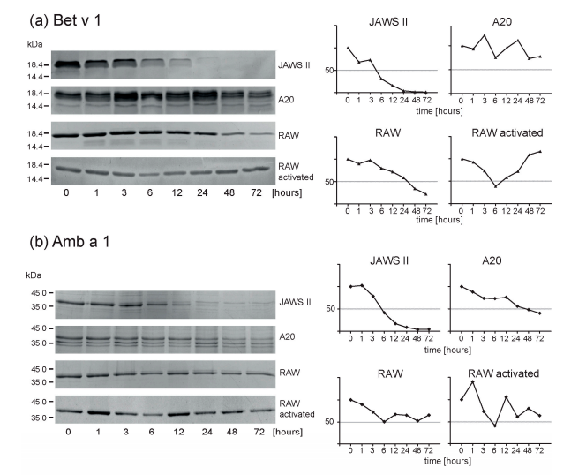
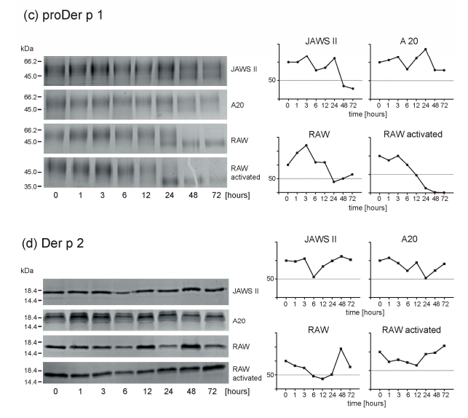
Endolysosomal degradation of allergens were performed under reducing conditions at 37°C, pH 4.8.
Notes:
Allergens were digested with endolysosomal proteases from different APCs. Reactions were stopped by heat inactivation of protease/allergen mixture and low pH resembled pH value of late endosome.
Activated RAW macrophages showed similar activity pattern to resting cells. Bet v 1 and Amb a 1 slowly degraded, proDer p 1 efficiently degraded, and Der p 2 showed hardly any reductions patterns of intact protein.

Slide 8
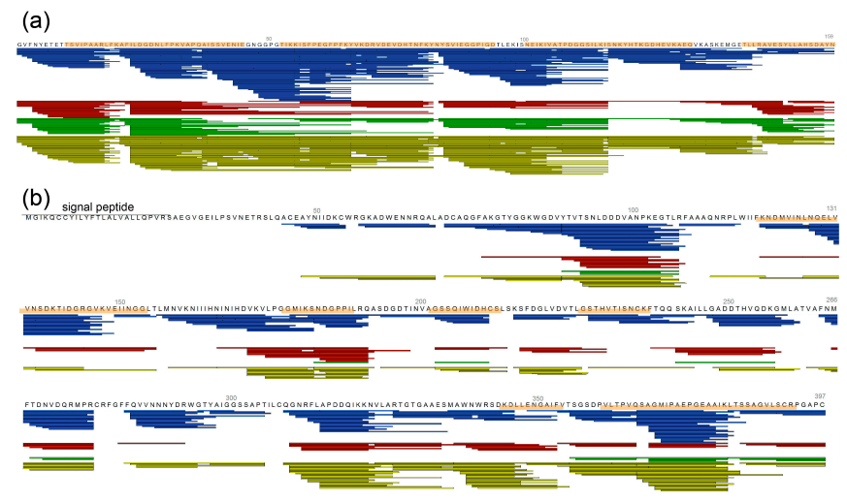
MS performed after 6h. Degradation analysis of all 4 allergens at 6 and 24 h showed no differences between cell lines.

Slide 9
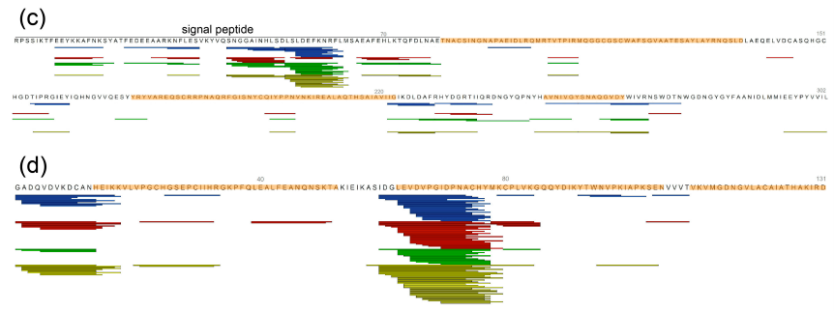
(cont…)

Slide 10
Conclusions
Despite minor differences in processing, the overall degradation patterns were similar across the digested allergens.
Activated macrophages show no difference in proteolytic patterns/activity when compared to unstimulated macrophages =>
Allergen degradation patterns are determined by the structure of the protein being degraded, not the source of the endolysosomal proteases.
In vitro protein degradations using isolated endolysosomal fractions from APCs are good T cell epitope predictors for in vivo degradation patterns.

